Slide 1
Software Construction & Development
Week 03
Abeeha Sattar

Slide 2
Layered Architecture

Slide 3
Layered Application Architecture
Presentation layer
Concerned with presenting the results of a computation to system users and with collecting user inputs
Application processing layer
Concerned with providing application specific functionality e.g., in a banking system, banking functions such as open account, close account, etc.
Data management layer
Concerned with managing the system databases
Notes:
Logical Separation of functionalities

Slide 4
Tiering
A two-tier architecture is one where a client talks directly to a server, with no intervening server
This type of architecture is typically used in small environments with less than 50 users
A three-tier architecture introduces another server (or an "agent") between the client and the server
The role of the middle-tier agent is many-fold - it can provide translation services as in adapting a legacy application on a mainframe to a client/server environnent
A plethora of software technologies have evolved to fill the middle tier - middleware
Notes:
Physical Separation/ Physical Machines

Slide 5
MVC Pattern
- Model
Model represents an object or JAVA POJO carrying data. It can also have logic to update controller if its data changes.
- View
View represents the visualization of the data that model contains.
- Controller
Controller acts on both model and view. It controls the data flow into model object and updates the view whenever data changes. It keeps view and model separate.
Notes:
POJO = Plain Old Java Object
It is an ordinary Java object, not bound by any special restriction other than those forced by the Java Language Specification and not requiring any classpath. POJOs are used for increasing the readability and re-usability of a program.

Slide 6
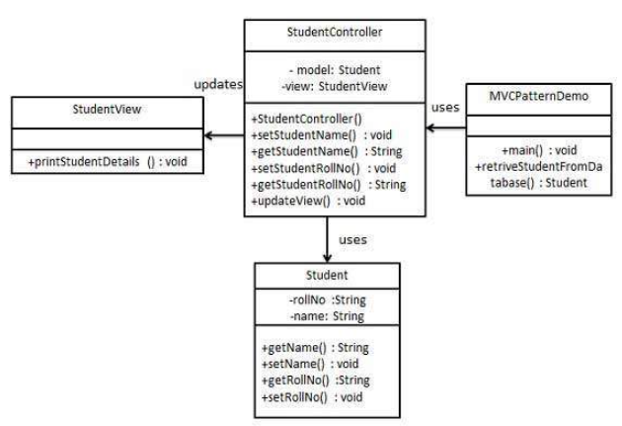
Example
Notes:
https://www.tutorialspoint.com/design_pattern/mvc_pattern.htm

Slide 7
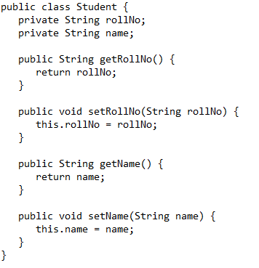
Student.java

Slide 8
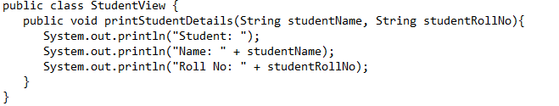
StudentView.java

Slide 9
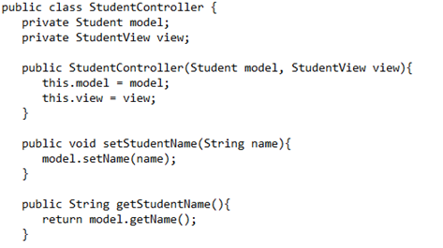
StudentController.java

Slide 10
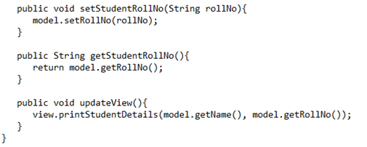
StudentController.java

Slide 11
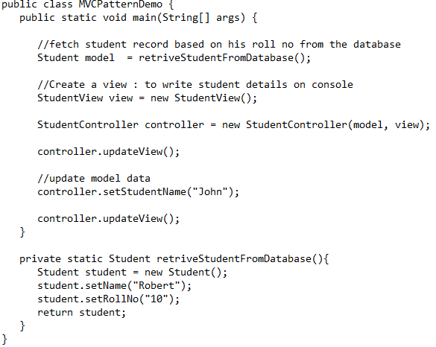
MVCPatternDemo.java

Slide 12
DAO Pattern
- Data Access Object
Has the following:
Data Access Object Interface - This interface defines the standard operations to be performed on a model object(s).
Data Access Object concrete class - This class implements above interface. This class is responsible to get data from a data source which can be database / xml or any other storage mechanism.
Model Object or Value Object - This object is simple POJO containing get/set methods to store data retrieved using DAO class.
Notes:
Data Access Object Pattern or DAO pattern is used to separate low level data accessing API or operations from high level business services.

Slide 13
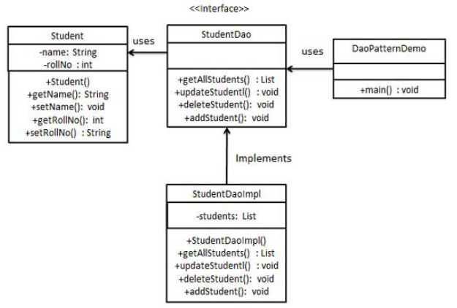
Example
Notes:
https://www.tutorialspoint.com/design_pattern/data_access_object_pattern.htm

Slide 14
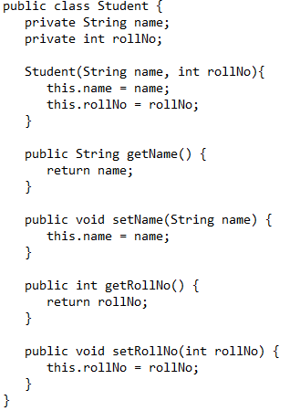
Student.java

Slide 15
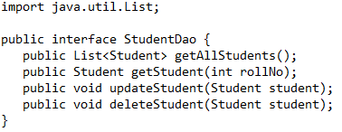
StudentDao.java

Slide 16
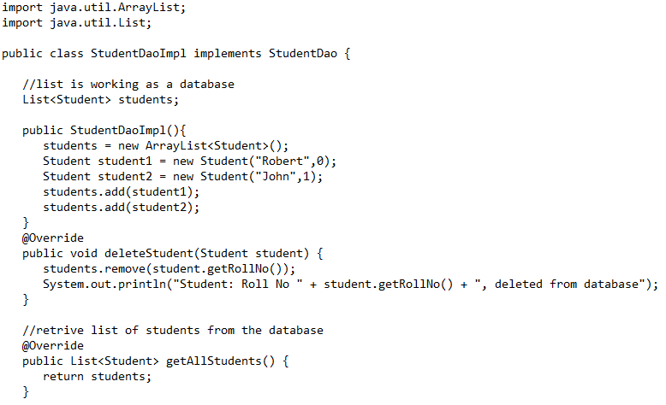
StudentDaoImpl.java

Slide 17
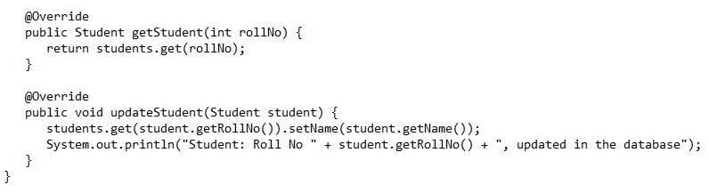
StudentDaoImpl.java

Slide 18
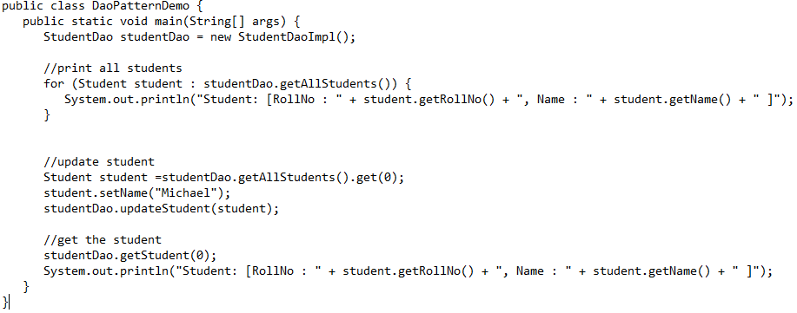
DaoPatternDemo.java

Slide 19
Fin.

